Slide 1
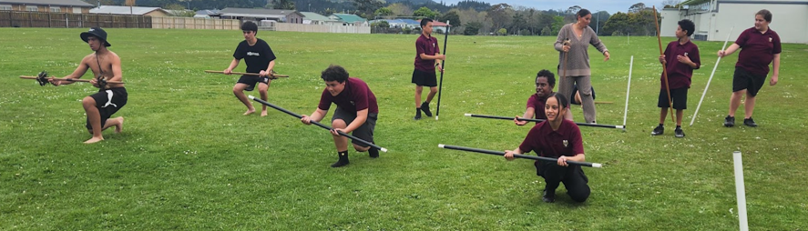
Tū Mārō
Kaupapa: Wananga, Atuatanga
Mātau
Whakamātautau
Kia mātau
Whakaū

Slide 2
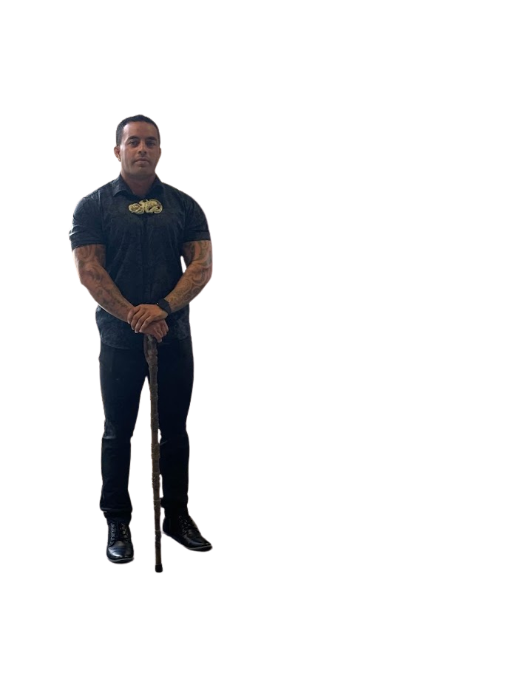
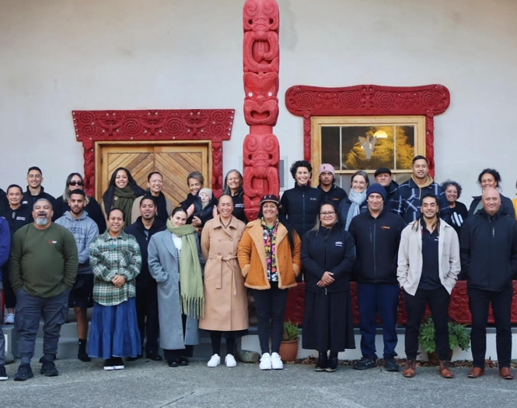
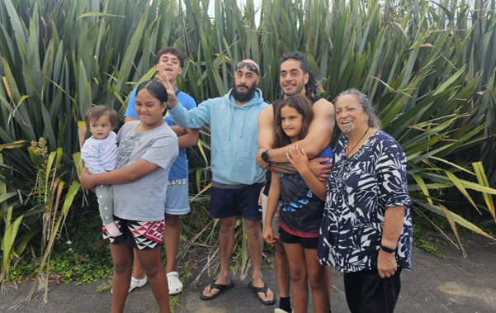
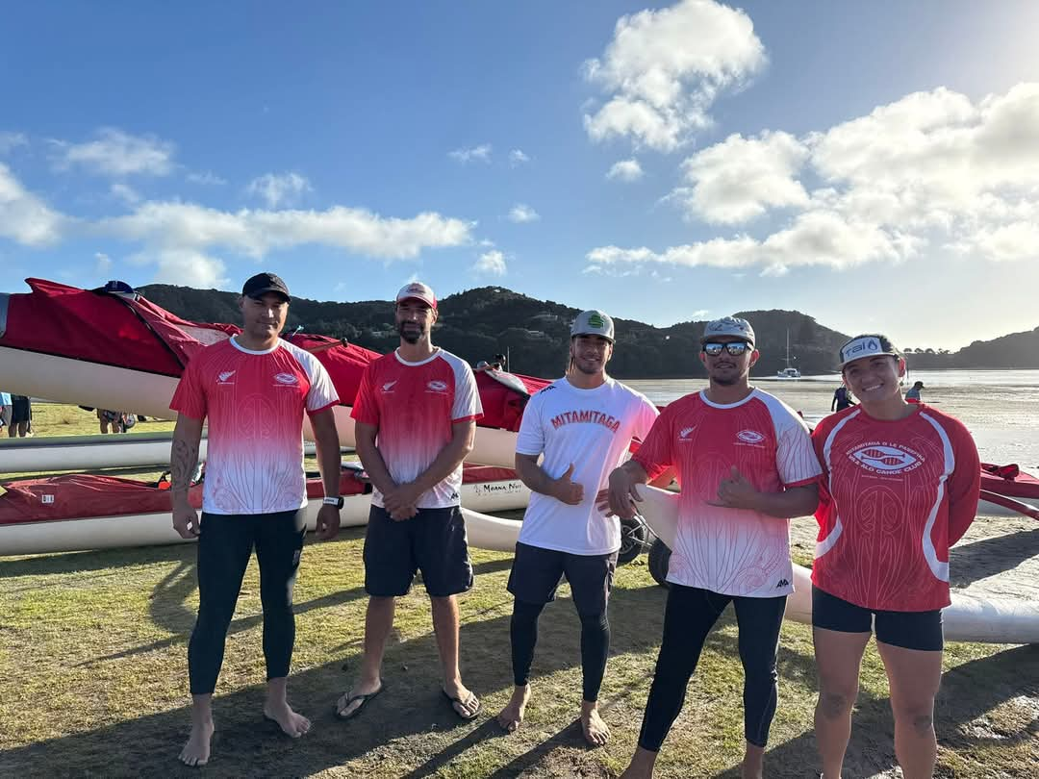
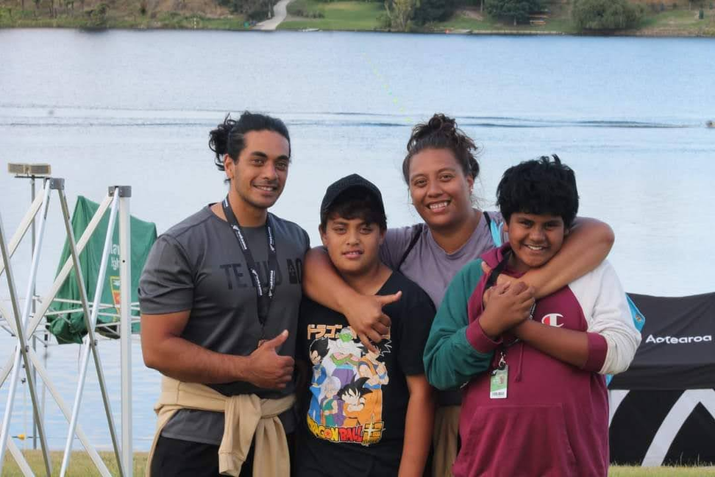
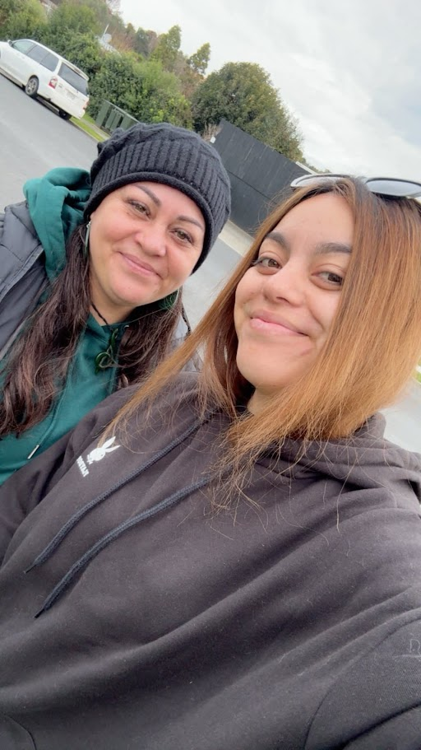
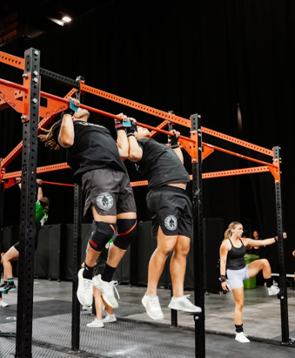
Ko wai au

Slide 3
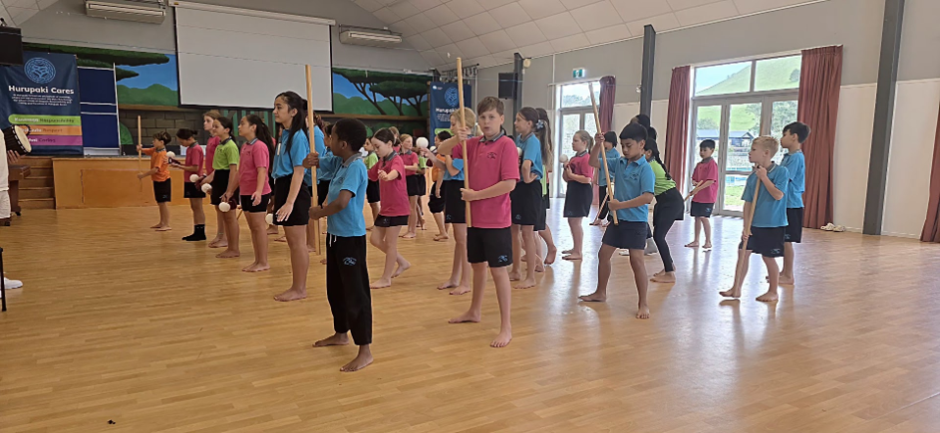
Whakatauāki
Ko tā te pukenga he Maramatanga
From wisdom comes enlightenment
Nā Te Wharehuia Rāpata
Notes:
“Before we get into Tū Māro and Atuatanga, I want to start this session not with content — but with thinking and reflection.”
“This is not a lecture. It’s a small wānanga. So we’ll be working together, talking together, and thinking together.”
“Some of the questions may sit comfortably, and some may challenge how we currently think about Physical Education.”

Slide 4
Patapatai?
What does physical education look like when it is grounded in mātauranga māori rather than sport, or traditional PE alone?
Notes:
To shift the whakaaro slightly” "
“As we talk about Atuatanga, whakapapa and movement, identity, and connection, not just physical output.”
“So in pairs”
“Where in your lessons in HPE do students experience cultural connection?”
“To themselves? To others? Or to something bigger than sport?”

Slide 5
What is Tū Mārō?
Ko tā te wananga he maioha,
From Knowledge comes compassion
Nā Te Pokiha Hēmana
If fitness was connected to Atua Māori, how might your lessons look like? what would you change?
Notes:
Wānanga
- Aim is to engage Atua māori and whakapapa
Mātau/Mātauranga
- What do I know, what do you know about atua
Whakamatau
- How do we test our whakaaro?
Kia mātau
- Have we agreed, or are we in agreeance
Practice with intention
- Whakaū/kōkiri
This is where we start to see what we value in PE.”
Unlocking potential

Slide 6
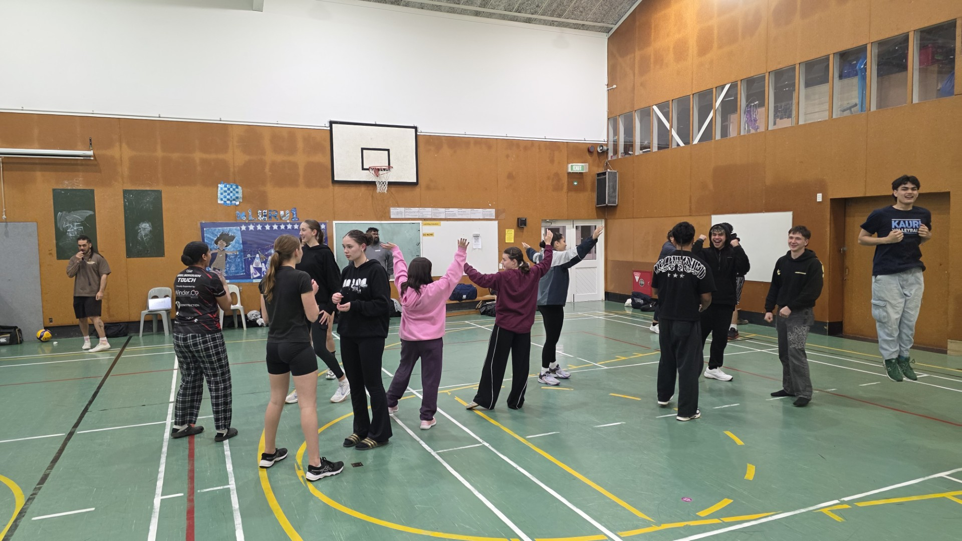
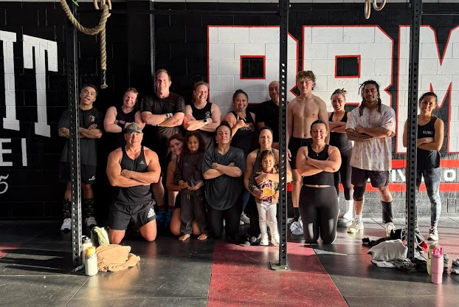

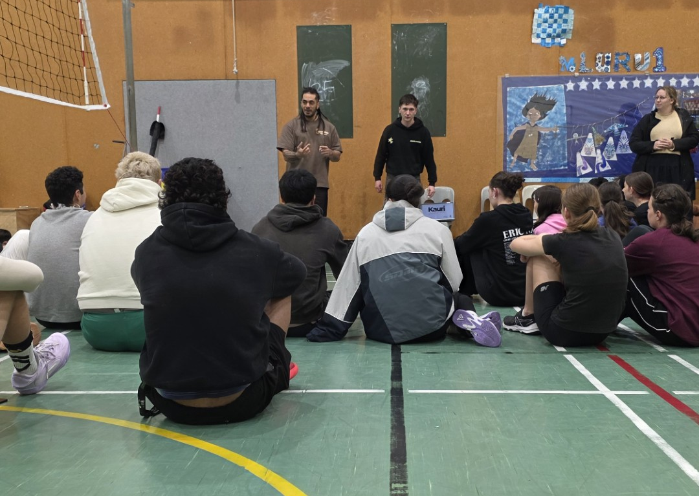
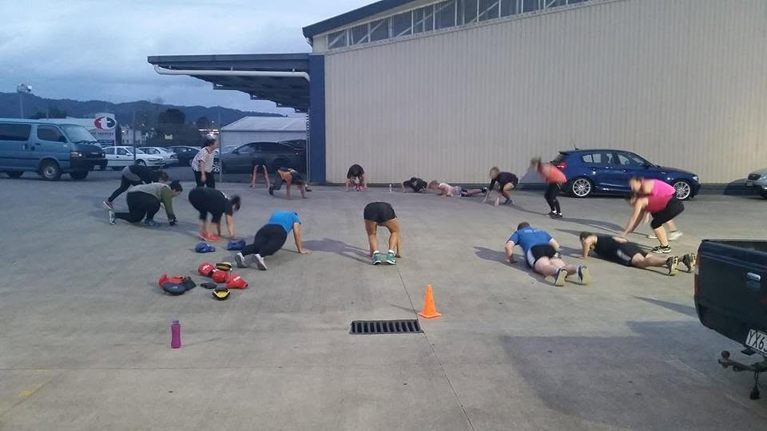

Wāhi Māori mō
te Ao Hākinakina
Ko te tuakiri te matakahuki o te kawa oranga

Slide 7
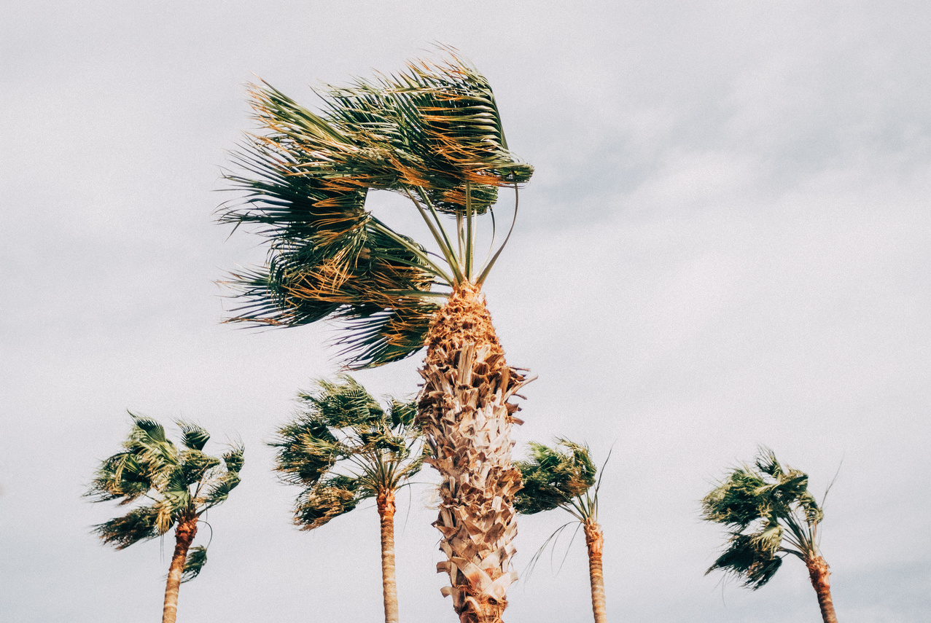
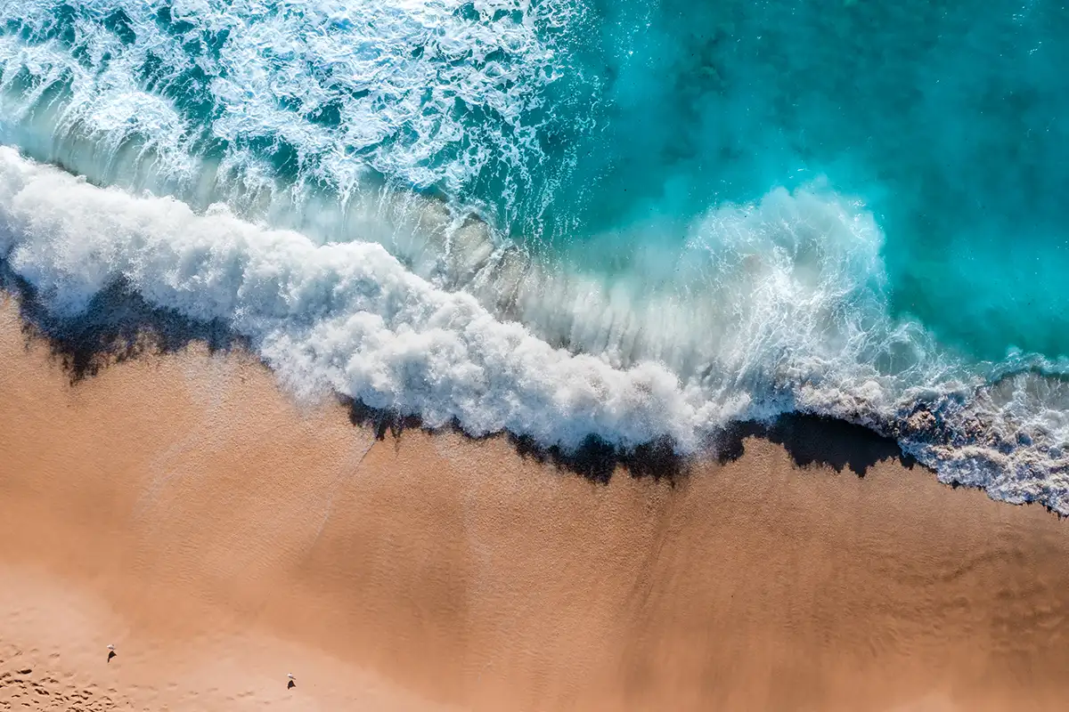
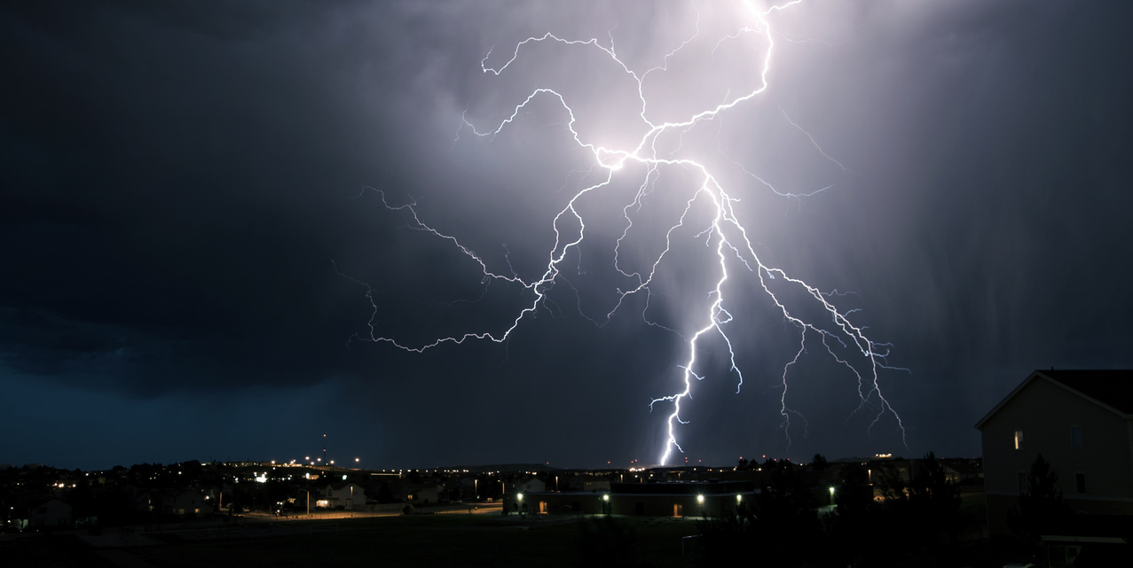
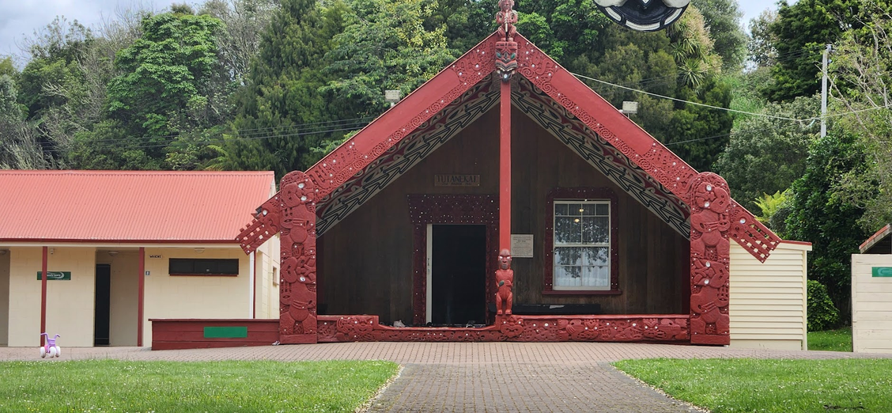
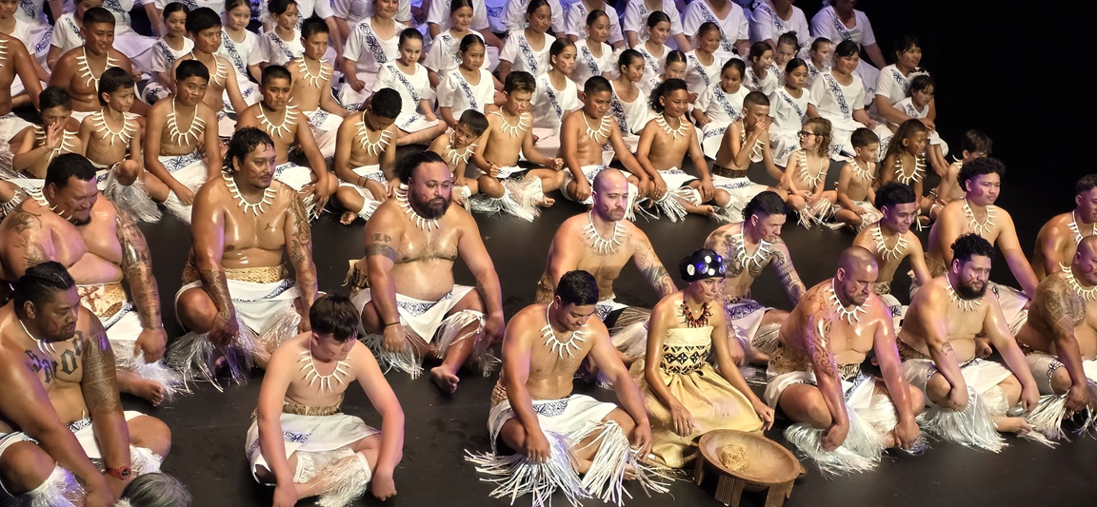
Whakamātautau
“Ko tā te maire he tāpiri”
“From belief comes solution”
Nā Hori Taia

Slide 8
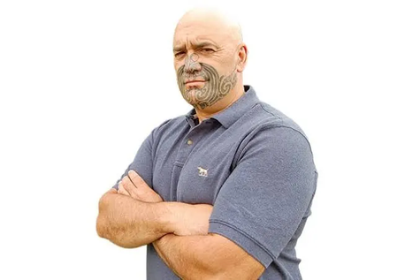
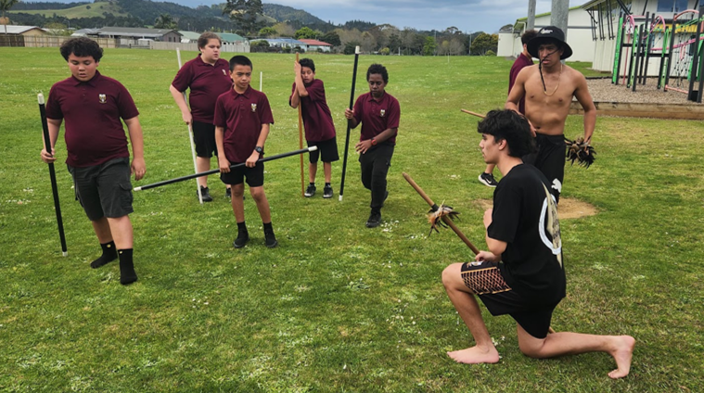



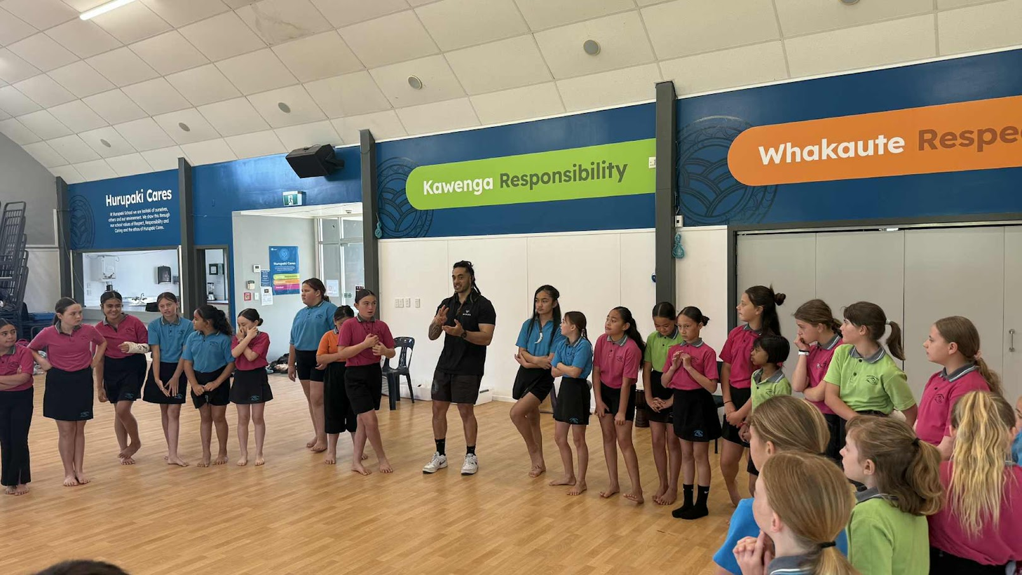
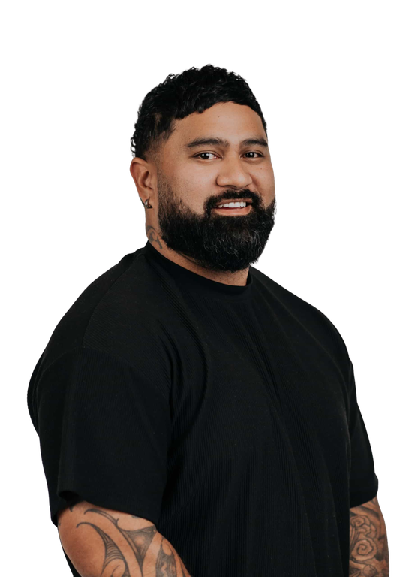
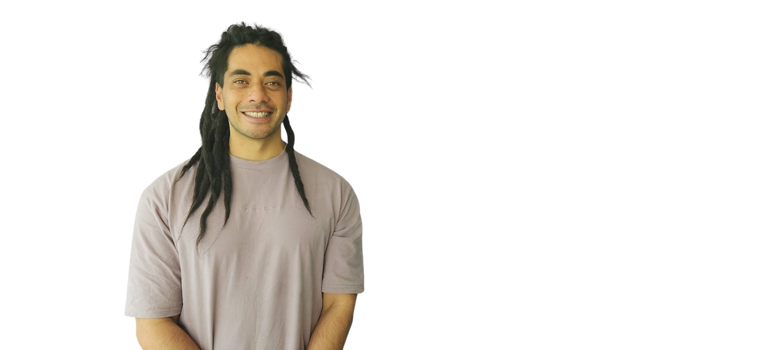

Te Whakapapa o Tū Mārō

Slide 9
MAIEA TĀWHIWHI ATU KI NGĀ ATUA
Nga Mihi nui
Notes:
E kitea te mea ngaro, e rangona te mea kore, e taea ai te otinga....
Perceive the invisible, feel the intangible, achieve the possible.....

